Slide 1
Factory AI – TCN
Jason Chang

Slide 2
Outline
Why TCN?
TCN in detail
TCN implementation (Keras TCN)

Slide 3
Why TCN?

Slide 4
Why TCN instead of RNN/DNN?
Better performance while avoiding common drawbacks of recurrent models, such as the exploding/vanishing gradient problem or lacking memory retention.
Performance improvements as it allows for parallel computation of outputs
Not to mention that DNNs are very memory consuming...

Slide 5
Darts library
 | TCN | NBeats | TFT | NHiTs | DeepAR
Year | 2018 | 2019 | 2019 | 2022 | 2017
Citation | 2533 | 284 | 244 | 7 | 740

Slide 6
TCN in detail

Slide 7
Overview
A TCN, short for Temporal Convolutional Network, consists of dilated, causal 1D convolutional layers with the same input and output lengths.
1D Convolutional Network
Causal Convolution
Dilation
Basic TCN Overview
Improvements to the Model (Final Model)

Slide 8
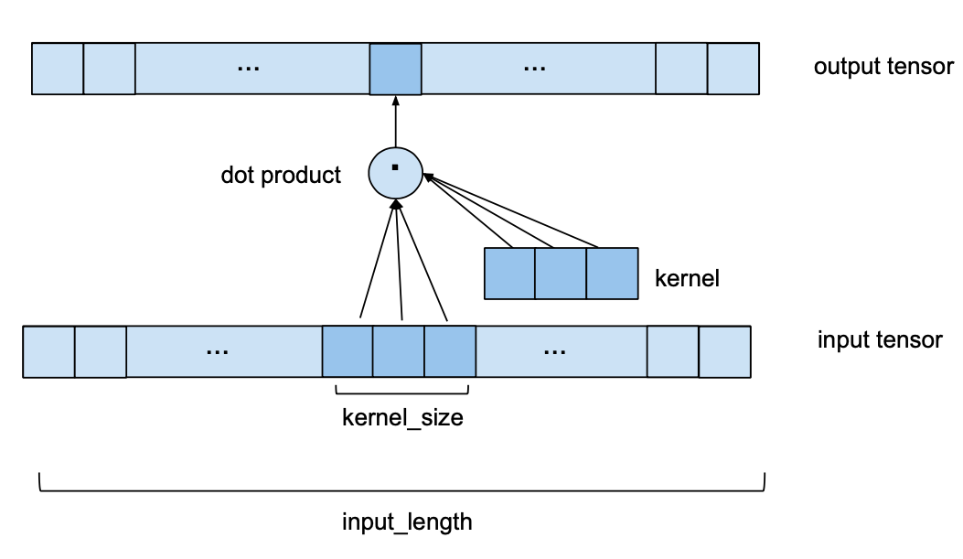
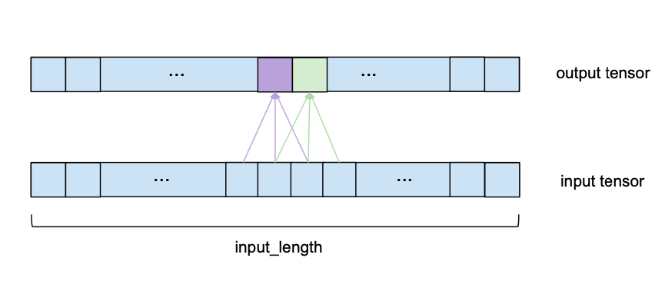
1D Convolutional Network (single channel)
Some zero-padding on the input is applied.
(How this is done exactly will be explained later.)
Input shape: (batch_size, input_length, 1)
Output shape: (batch_size, input_length, 1)

Slide 9
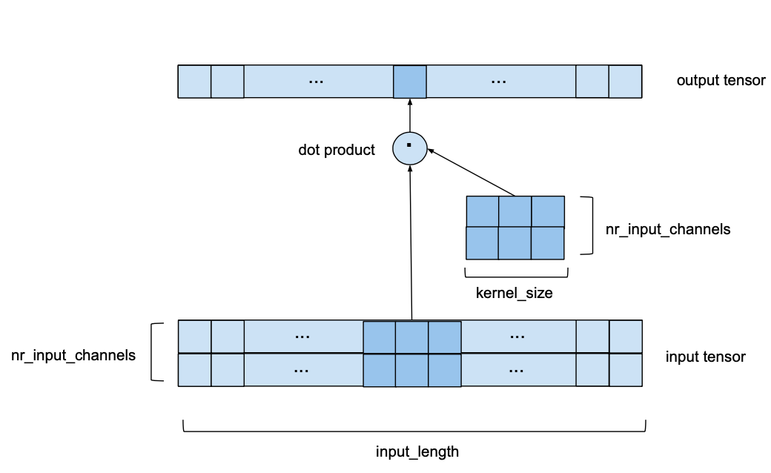
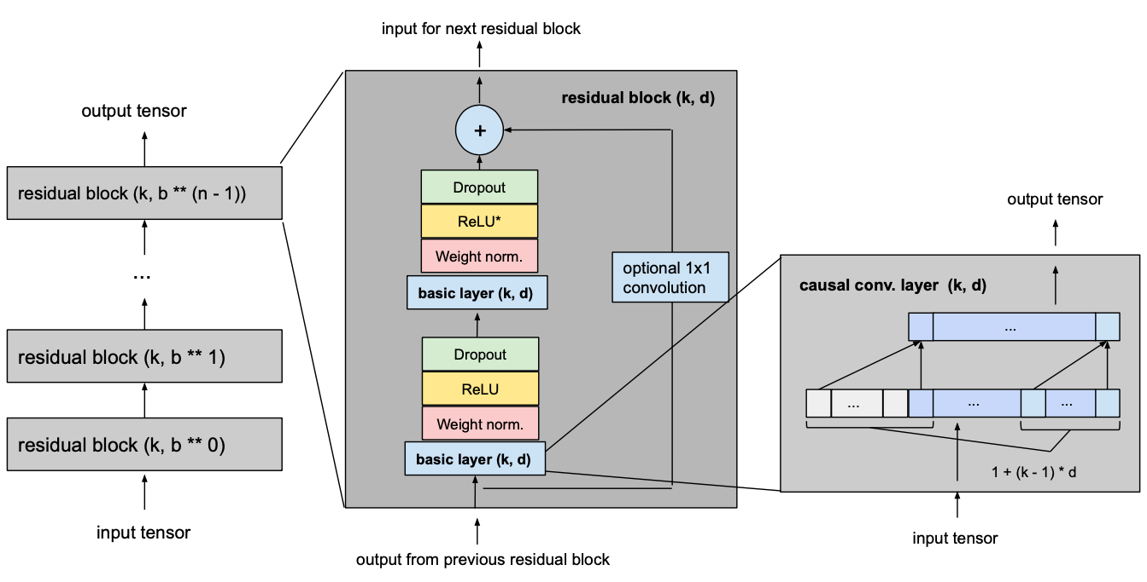




1D Convolutional Network (multiple channels)
in terms of channels
$$output_size$$
$$num_filters$$
$$num_filters$$
$$input_size$$
Input shape: (batch_size, input_length, nr_input_channels)
Output shape: (batch_size, input_length, nr_output_channels)
$nr_input_channels = input_size$. $nr_output_channels = output_size$.

Slide 10
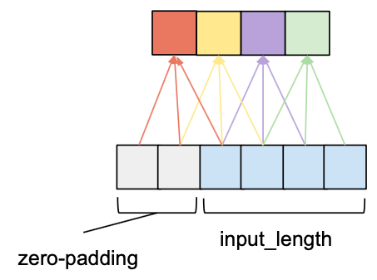
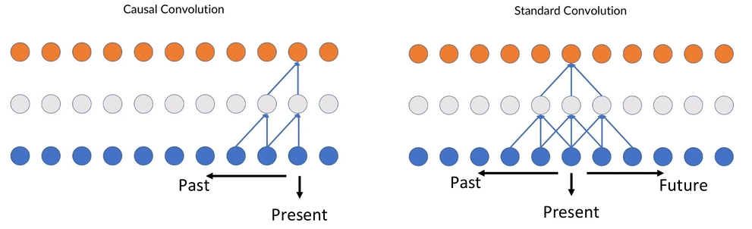
Causal Convolution
An element in the output sequence can only depend on elements that come before it in the input sequence.
If we only apply zero-padding on the left side of the input tensor, then causal convolution will be ensured.

Slide 11
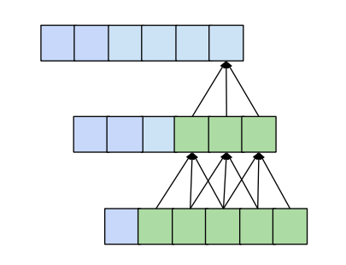

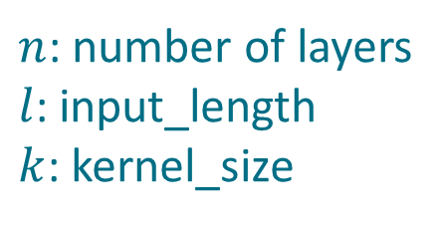
Why do we need dilation?
Given a fixed $kernel_size$, the number of layers required for full receptive field coverage is linear in the length of the input tensor.
Which will result in networks that become very deep very fast
$n$: number of layers
$l$: input_length
$k$: kernel_size

Slide 12
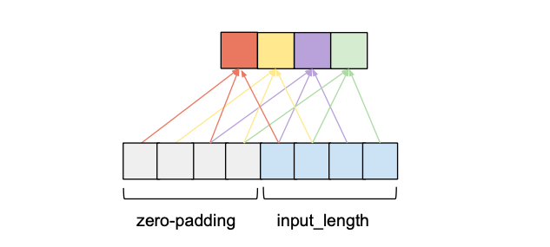


Dilation
$Dilation$ in the context of a convolutional layer refers to the distance between the elements of the input sequence that are used to compute one entry of the output sequence.
Normal 1D convolution has $dilation = 1$
$$Dilation = 2$$

Slide 13
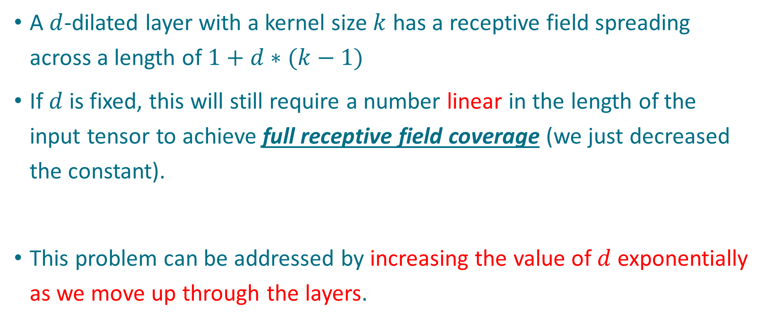
Still being linear…
A $d$-dilated layer with a kernel size $k$ has a receptive field spreading across a length of $1+d∗(k−1)$
If $d$ is fixed, this will still require a number linear in the length of the input tensor to achieve full receptive field coverage (we just decreased the constant).
This problem can be addressed by increasing the value of $d$ exponentially as we move up through the layers.

Slide 14
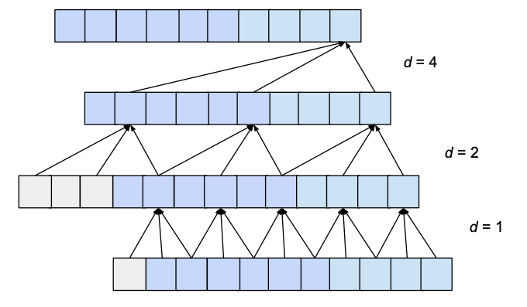

Increase $d$ exponentially
We choose a constant $dilation_base$ integer $b$
$d=b^{i}$, $i$ is the index of layers
We can see that the number of layers is now logarithmic rather than linear in the length of the input.

Slide 15
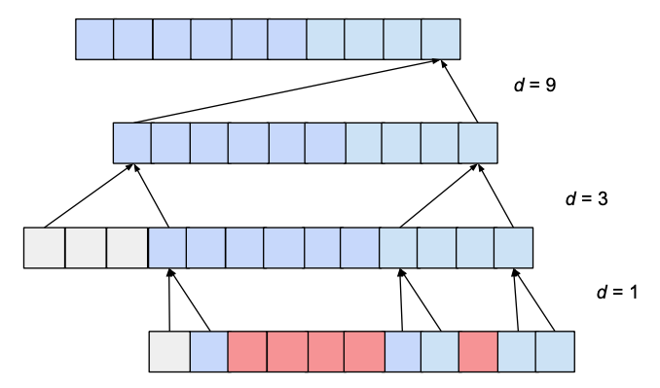

Holes
Depending on the values 𝑏 (𝑑𝑖𝑙𝑎𝑡𝑖𝑜𝑛_𝑏𝑎𝑠𝑒) and 𝑘 (𝑘𝑒𝑟𝑛𝑒𝑙_𝑠𝑖𝑧𝑒), the receptive field can have holes.
Ex: $b=3, k=2$
$k≥b$ for a receptive field with no hole

Slide 16
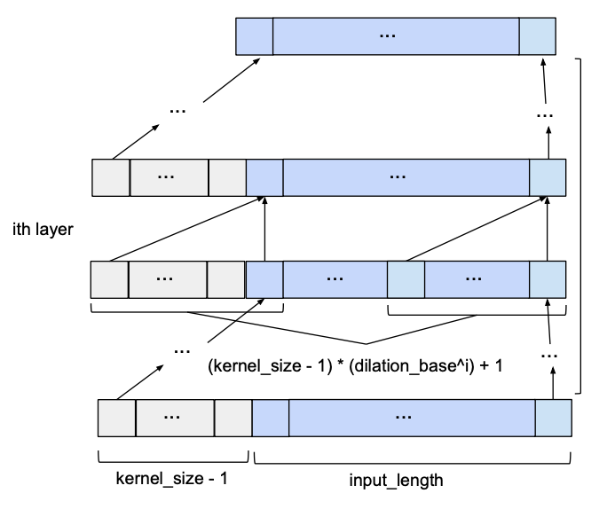
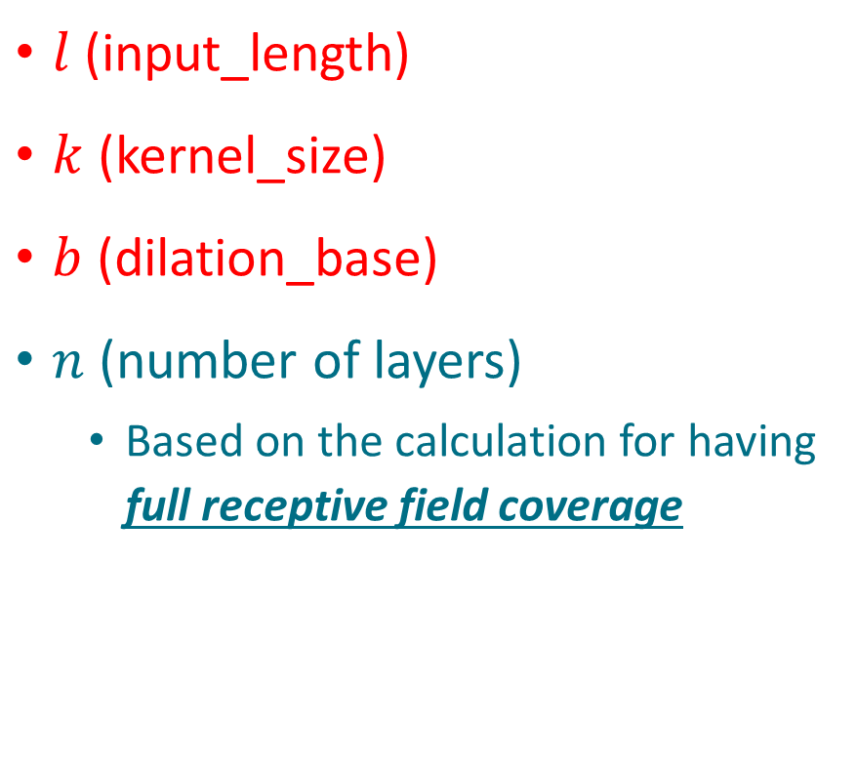
Basic TCN Overview
$l$ (input_length)
$k$ (kernel_size)
$b$ (dilation_base)
$n$ (number of layers)
Based on the calculation for having full receptive field coverage

Slide 17
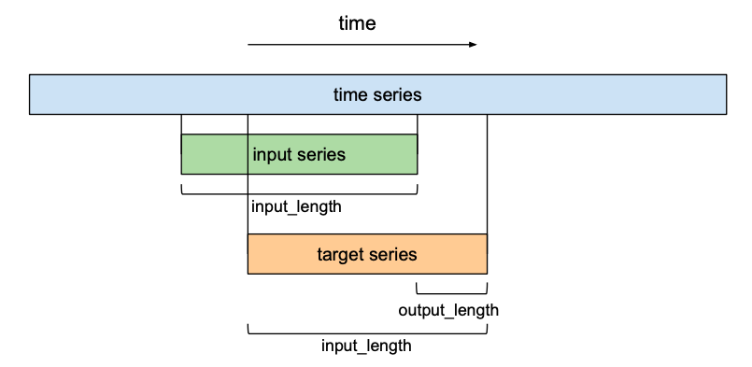



Forecasting
$output_length$ is not necessarily equal to $input_length$
$$input$$
$$output$$
$$start_index: input_length – output_length$$

Slide 18
Improvements to the Model
Residual Blocks
Activation, Normalization, Regularization

Slide 19
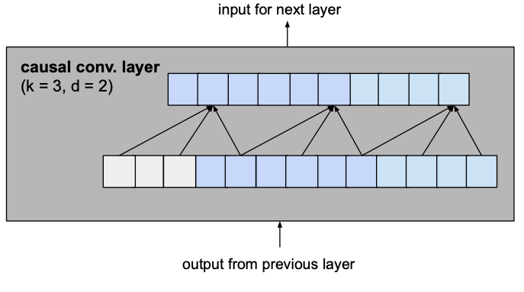
Residual Blocks
As was
A simple 1D causal convolutional layer

Slide 20
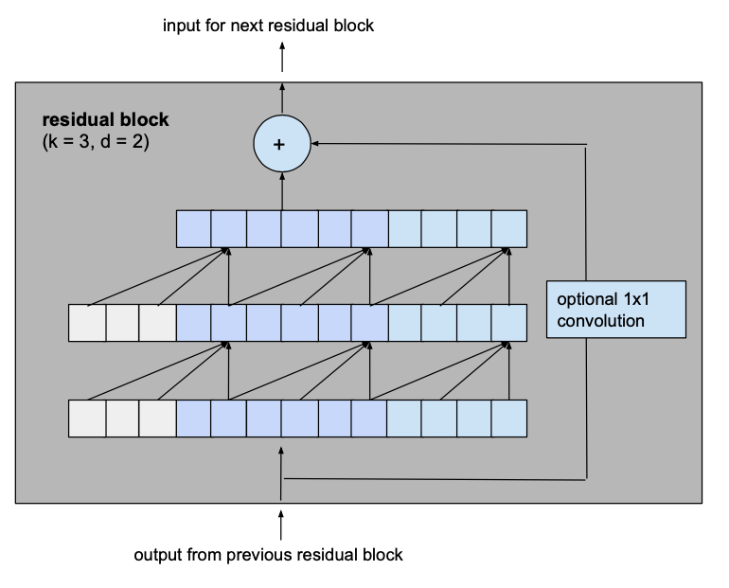
Residual Blocks
As is
A residual block which consists of 2 layers with the same dilation factor and a residual connection
Why?
(We know that the purpose of 1x1 conv is to change the #channels)

Slide 21






1x1 Conv
$$output_size$$
$$num_filters$$
$$num_filters$$
$$num_filters$$
$$num_filters$$
$$input_size$$
Only for the first block and the last block

Slide 22
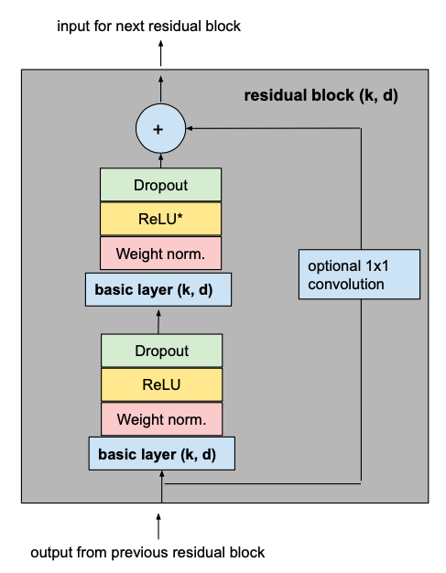
Activation, Normalization, Regularization
Activation
ReLU
Normalization
Weight Normalization
Regularization
Dropout
The asterisk in the second ReLU unit indicates that it is present in every layer but the last one, since we want our final output to be able to take on negative values as well (this differs from the architecture outlined in the paper).

Slide 23

Final Model
$l$ (input_length)
$k$ (kernel_size)
$b$ (dilation_base)
$n$ (number of layers)
Based on the calculation for having full receptive field coverage

Slide 24
TCN implementation (Keras TCN)

Slide 25
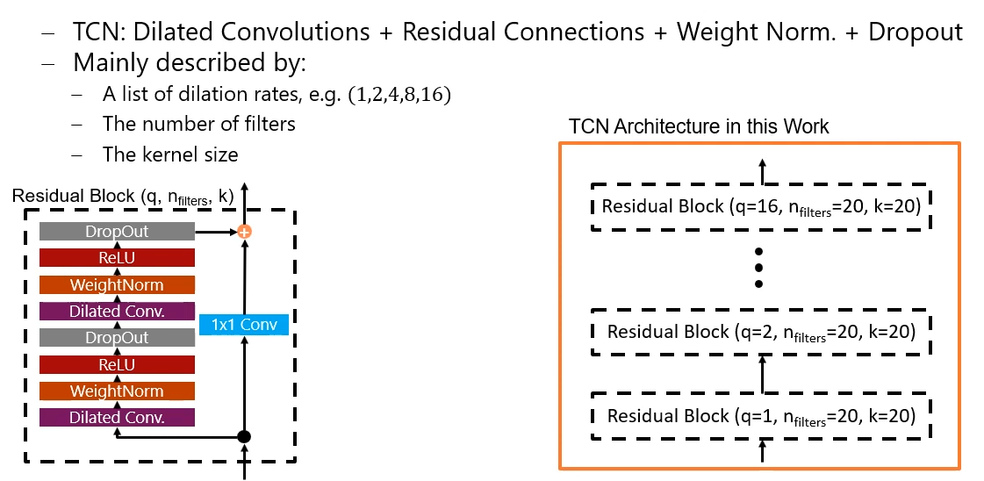
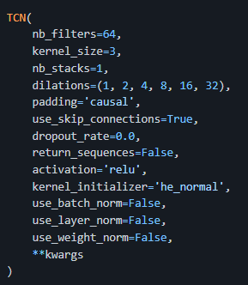


Keras TCN
CNN → Conv2D (#kernel increase)
TCN → Residual Block (q increase)
?
It’s still $tf.keras.Layer$, not $tf.keras.Model$

Slide 26
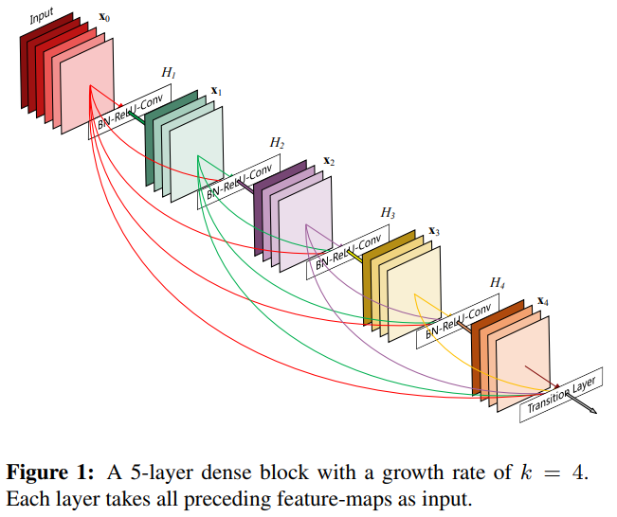



use_skip_connections
It’s the idea from DenseNet, not ResNet.

Slide 27
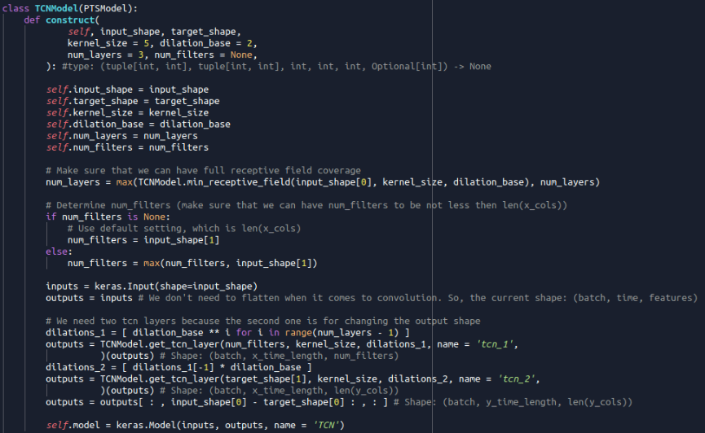
$TCNModel$ for FactoryAI
$num_layers$ will set to at least cover all receptive field.

Slide 28








$TCNModel$ for FactoryAI
$num_filters$ will set to be not less then $input_size$.
$$(batch, time, feature)$$
$$output_size$$
$$num_filters$$
$$num_filters$$
$$num_filters$$
$$num_filters$$
$$≤$$
$$input_size$$

Slide 29
$TCNModel$ for FactoryAI
2-layer TCN layers (we need to change back to $output_size$)
$$(batch, time, feature)$$
$$output_size$$
$$num_filters$$
$$num_filters$$
$$num_filters$$
$$num_filters$$
$$input_size$$

Slide 30


$TCNModel$ for FactoryAI
$$start_index: input_length – output_length$$
$$(batch, time, feature)$$
We need to change back to $output_length$

Slide 31
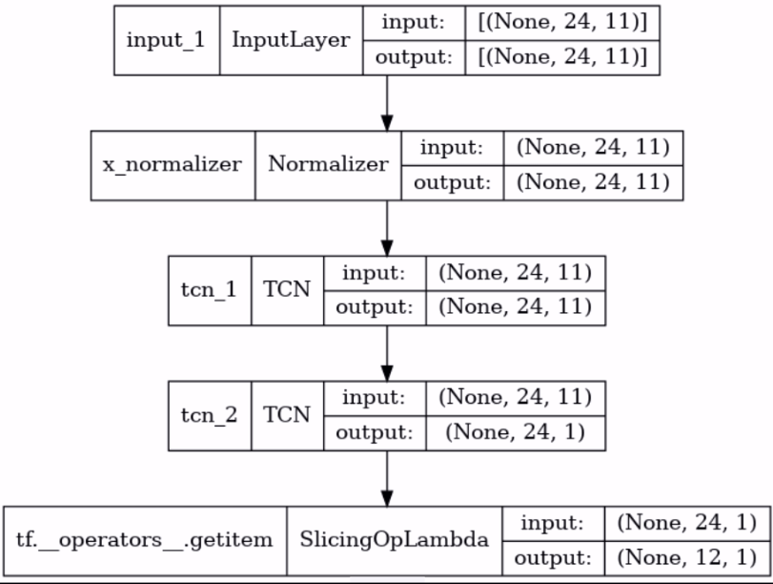

TCN with weather dataset
$input_length=24$
$output_length=12$
$\#x_cols=11$
$\#y_cols=1$
$num_filters=None$

Slide 32
Thanks for your attention

